Slide 1
Week 7
Sampling, Sampling Distributions, and Other Ideas

Slide 2
hypothesis testing spring break test 2
Notes:
We only have a few concepts to explore in this section but don’t let that fool you. This is going to be a heck of a time.
From this point on, class will be building quickly.

Slide 3
where we going?
Notes:
We only have a few concepts to explore in this section but don’t let that fool you. This is going to be a heck of a time.
From this point on, class will be building quickly.

Slide 4
research process
Notes:
We only have a few concepts to explore in this section but don’t let that fool you. This is going to be a heck of a time.
From this point on, class will be building quickly.

Slide 5
correlations chi-squared test 3
Notes:
We only have a few concepts to explore in this section but don’t let that fool you. This is going to be a heck of a time.
From this point on, class will be building quickly.

Slide 6
regression more regression test 4
Notes:
We only have a few concepts to explore in this section but don’t let that fool you. This is going to be a heck of a time.
From this point on, class will be building quickly.

Slide 7
types of sampling point vs interval
Notes:
We only have a few concepts to explore in this section but don’t let that fool you. This is going to be a heck of a time.
From this point on, class will be building quickly.

Slide 8
let’s go!
Notes:
Alright! Let’s do some stats.

Slide 9
population types
Notes:
Finite vs Infinite.

Slide 10
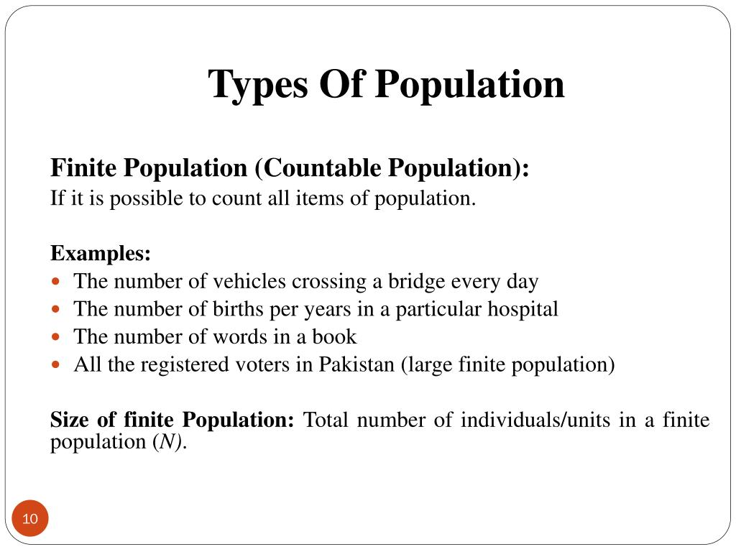
Notes:
Finite vs Infinite.
All MMO players of a specific MMO
Every game of Valorant
Members of Congresss
Every tank in the world
All people on airplanes
Every sale at a target
Every book in a library
Every American
Everyone in China
Everyone in India
Everyone in Omaha

Slide 11
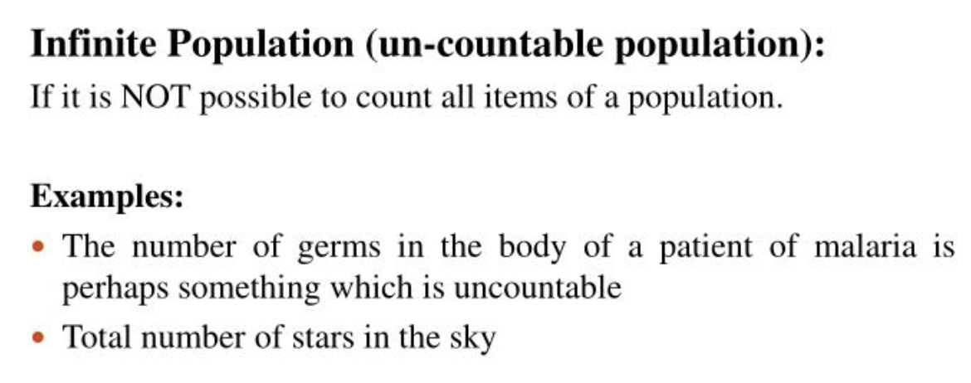
Notes:
Finite vs Infinite.
Every star in creation
Every human being
Every cell in a body
Grains of sand on a beach
Toxic players in league of legends

Slide 12
FRAMES
Notes:
> A **statistic** (those things we generate with sample data) will *change a lot*. For example, if I compare the average student debt of new, established, and retirement age faculty members in the US.
A **parameter** is what we're going for. We know through the law of large numbers, the central limit theorem, that the more samples we take, if we average those samples, that, once we got enough, we'd know the values for the population, the parameters. *Parameters do not change* once known (aside from drifting as all things do over time).
Why are these important?
Well, these are basically a list of the items or people forming a population from which a sample is taken.
What does that mean? What does it look like?

Slide 13
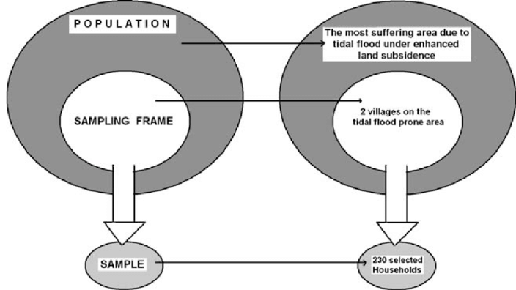
Notes:
So we’re approaching the idea of an experiment. We want to DO something to generate some data and gain some insights.
To do that, we know we have to sample. Setting up what we’ll sample and how much we need means that we have to really sit down and think it out.
Examples?

Slide 14
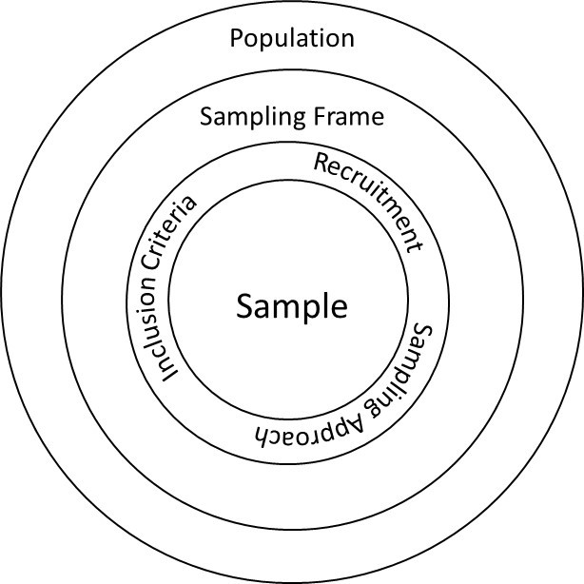
Notes:
So this is a fantastic illustration. Let’s look at this a bit more. What all is here?

Slide 15
point estimation (Our pal Z is back…kind of!)
Notes:
So let’s talk a bit about points.
In general, we can say that within frequentist statistics we can generally do 2 things, describe and make an inference. In this section of class, we will be generally approaching single values and those single values are called Point Estimates. In the future, we will be taking this idea of point estimation and expand it into, "interval estimation."
We should connect this back to the normal curve since this is our home now. It is where we live. And so, one of the easiest ways to describe point estimation is to use a different definition of the same thing: central tendency.
Do you remember calculating all of the modes of central tendency? Mean, Median, Mode? These are all estimates of population parameters.
Why? What? Huh?
These point estimations are just what we've been doing with Z-Scores. We use single points as estimates of population parameters. We are essentially offering an 'educated guess' about one aspect of the population given the sample we've collected.
Of the different kinds of point estimation, we have:
Mean
Median
Mode
Points

Slide 16
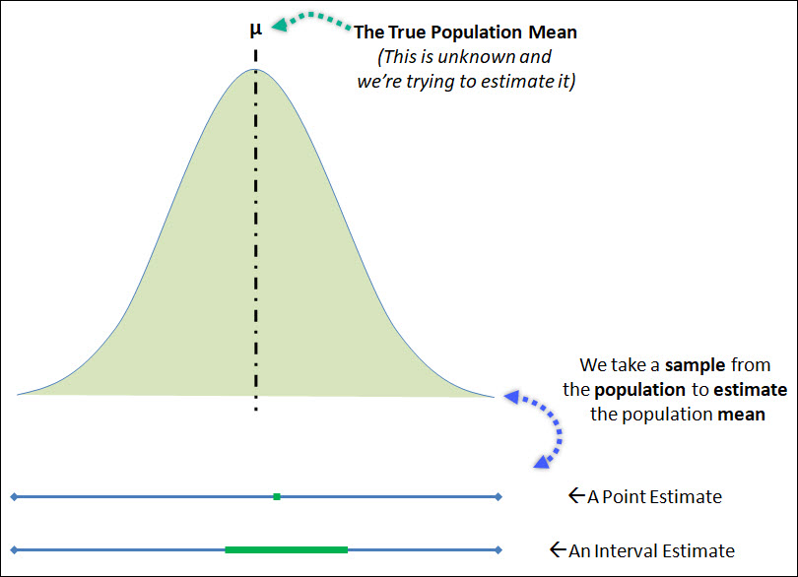
Notes:
Let’s dig into this a bit more.

Slide 17
sampling errors
Notes:
Finite vs Infinite.
A sampling error is a statistical error that occurs when an analyst does not select a sample that represents the entire population of data.
https://www.investopedia.com/terms/s/samplingerror.asp#:~:text=A%20sampling%20error%20is%20a,obtained%20from%20the%20entire%20population.
Why Is Sampling Error Important?
Being aware of the presence of sampling errors is important because it can be an indicator of the level of confidence that can be placed in the results. Sampling error is also important in the context of a discussion about how much research results can vary.
Sampling error occurs when a sample drawn from a population deviates somewhat from that true population. Large sampling errors can lead to incorrect estimates or inferences made about the population based on statistical analysis of that sample.
In general, sampling errors can be placed into four categories: population-specific error, selection error, sample frame error, or non-response error.
A population-specific error occurs when the researcher does not understand who they should survey.
A selection error occurs when respondents self-select their participation in the study. (This results in only those that are interested in responding, which skews the results.)
A sample frame error occurs when the wrong sub-population is used to select a sample.
Finally, a non-response error occurs when potential respondents are not successfully contacted or refuse to respond.

Slide 18
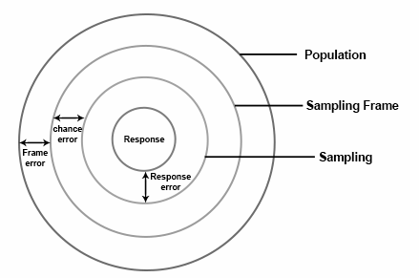
Notes:
Finite vs Infinite.
A population-specific error occurs when the researcher does not understand who they should survey.
A selection error occurs when respondents self-select their participation in the study. (This results in only those that are interested in responding, which skews the results.)
A sample frame error occurs when the wrong sub-population is used to select a sample.
Finally, a non-response error occurs when potential respondents are not successfully contacted or refuse to respond.
Chance Error
Chance error and bias are two different forms of error associated with sampling.
LEARNING OBJECTIVE
Differentiate between random, or chance, error and bias
KEY POINTS
The error that is associated with the unpredictable variation in the sample is called a random, or chance, error. It is only an "error" in the sense that it would automatically be corrected if we could survey the entire population.
Random error cannot be eliminated completely, but it can be reduced by increasing the sample size.
A sampling bias is a bias in which a sample is collected in such a way that some members of the intended population are less likely to be included than others.
There are various types of bias, including selection from a specific area, self-selection, pre-screening, and exclusion.
TERMS
bias
(Uncountable) Inclination towards something; predisposition, partiality, prejudice, preference, predilection.
random sampling
a method of selecting a sample from a statistical population so that every subject has an equal chance of being selected
standard error
A measure of how spread out data values are around the mean, defined as the square root of the variance.
Bias
In statistics, sampling bias is a bias in which a sample is collected in such a way that some members of the intended population are less likely to be included than others. It results in a biased sample, a non-random sample of a population in which all individuals, or instances, were not equally likely to have been selected. If this is not accounted for, results can be erroneously attributed to the phenomenon under study rather than to the method of sampling.
There are various types of sampling bias:
Selection from a specific real area. For example, a survey of high school students to measure teenage use of illegal drugs will be a biased sample because it does not include home-schooled students or dropouts.
Self-selection bias, which is possible whenever the group of people being studied has any form of control over whether to participate. Participants' decision to participate may be correlated with traits that affect the study, making the participants a non-representative sample. For example, people who have strong opinions or substantial knowledge may be more willing to spend time answering a survey than those who do not.
Pre-screening of trial participants, or advertising for volunteers within particular groups. For example, a study to "prove" that smoking does not affect fitness might recruit at the local fitness center, but advertise for smokers during the advanced aerobics class and for non-smokers during the weight loss sessions.
Exclusion bias, or exclusion of particular groups from the sample. For example, subjects may be left out if they either migrated into the study area or have moved out of the area.

Slide 19
Sampling Distributions
Notes:
Finite vs Infinite.

Slide 20
Repeated Sampling

Slide 21
what kinds of samples?
Notes:
So we’ve talked a bit about estimation via sampling, but it’s weirder than that. Let’s consider 3 words/terms:
Population Parameter are those statistics
Sample Statistics is found using the sample of people from the target population.
Target Population is the population we want to make inferences on.
And so what?
Take this nugget from your book: “Whenever a sample is used to make inferences about a population, we should make sure that the study is designed so that the sampled population and the target population are in close agreement. Good judgement is a necessary ingredient of sound statistical practice (this is also true of things like ethics and data). P.329.

Slide 22
Simple Random Sample
Notes:
Simple Random Sample.
All of the population has an equal probability to be selected.
What does this mean?
EXCEL EXAMPLE from 7.2
Finite Population Examples:

Slide 23
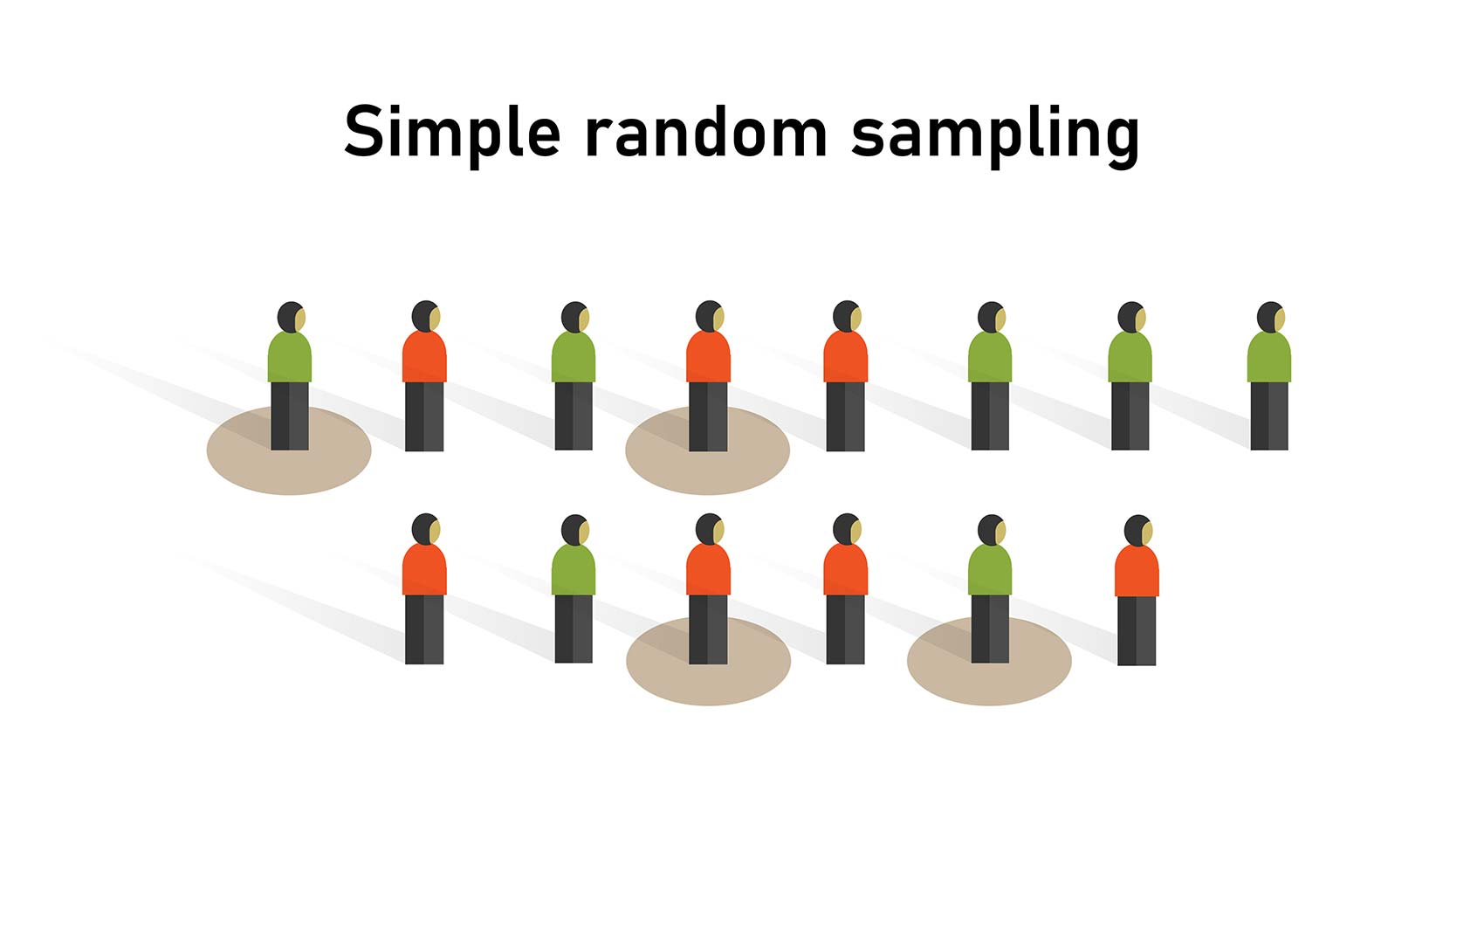
Notes:
Simple Random Sample.
All of the population has an equal probability to be selected.
What does this mean?
EXCEL EXAMPLE from 7.2
Finite Population Examples:

Slide 24
Random Sample (infinite population)
Notes:
For the most part, we’ve spent some time travelling up a mountain. Now that we’re at the top, we’ll be rolling down hill. This section is all about sampling and various ways things can go wrong. We’ll also be doing t-tests, and other stuff.
A random sample of size n from an infinite population is a sample selected such that the following conditions are satisfied:
Each element selected comes from the same population.
Each element is selected independently.
And so we see here the word infinite, but what does that mean?
Examples of infinite pop:

Slide 25
Other Kinds of Sampling
Notes:
Stratified Random Sampling
Cluster Sampling
Systematic Sampling
Convenience Sampling
Judgement Sampling

Slide 26
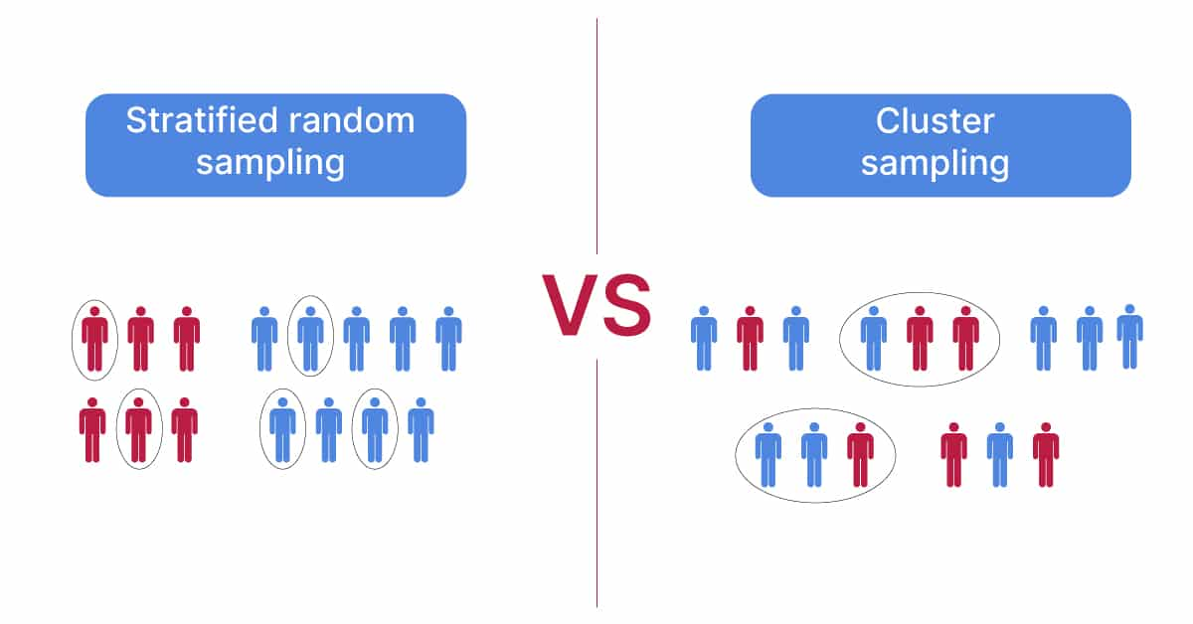
Notes:
Stratified Random Sampling
Cluster Sampling
Systematic Sampling
Convenience Sampling
Judgement Sampling

Slide 27
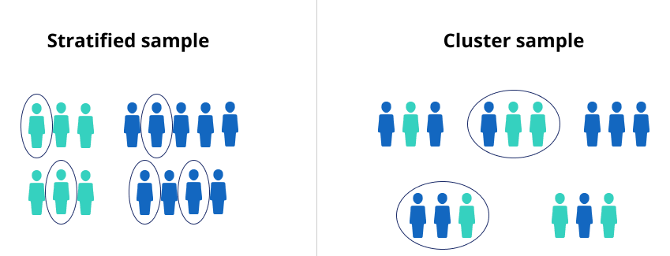
Notes:
Stratified Random Sampling
Cluster Sampling
Systematic Sampling
Convenience Sampling
Judgement Sampling

